Slide 1
Occlusion Handling in Behavior Planning using Imitation Learning
Janaranjani Palaniswamy
Supervisor: Stoll Martin
Monthly Status Update - 17.1.2022

Slide 2
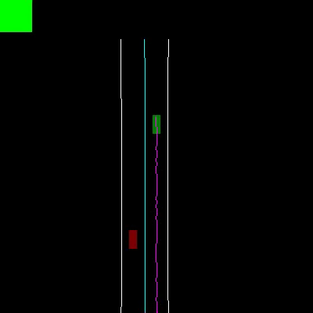
Project Objective
To implement an occlusion handling algorithm using object filters and observe the policy crash.
Update the training data using occlusion algorithm.
Extension of IDM to adapt the new data.
Add visibility layer to grid data and perform hyperparameter tuning using AutoML.
Further steps: learn object detections in occluded area, non geo-fixed occlusions, and comparison with different neural network architectures.

Slide 3
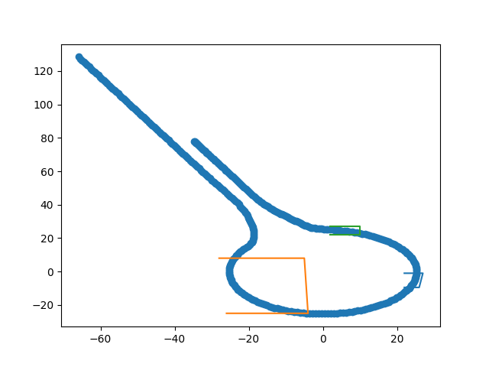
Earlier Work
Literature work on base papers.
Familiarized with the code base through bug fixes.
Defined occlusion zones for the roundabout scenario.
Implemented an object filter class to generate filtered rollout.

Slide 4
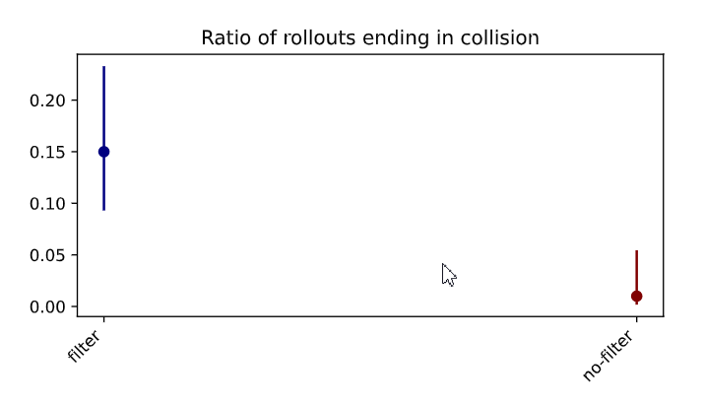
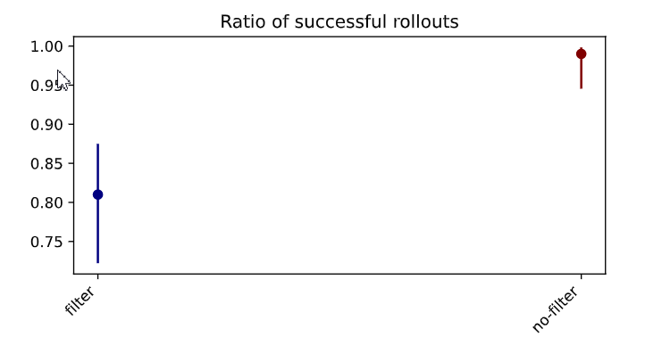
Progress
Adapted the environment using object filter to occlude the defined zones.
Evaluated the occlusion algorithm through policy crash.
Ablation study on filtered and non-filtered rollouts by comparing the KPIs

Slide 5
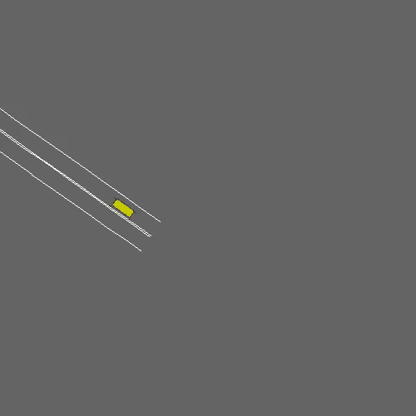
Implementation in progress
Progress
Adapting the IDM expert to handle the risk of occluded regions.
Spawn a vehicle into the occusion zone.
Idm hallucinates the hidden vehicle and handle the conflict policies.
Environment with occlusion zones

Slide 6
Next Monthly Forecast Plan
Further Steps
Complete the IDM adaptation.
Dynamic zone (maybe) - Sol1= object filter dependent on ego position
Sol2 = In object_filter = define the ego area. Before filtering the frame
Generate new training data with the new expert.
Training and evaluation of the policy with new dataset.
Visibility layer to data

Slide 7
Further Steps

Slide 8
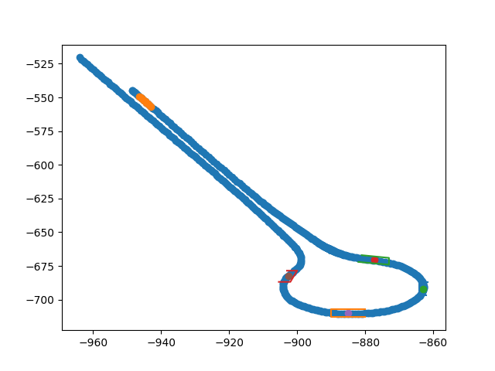
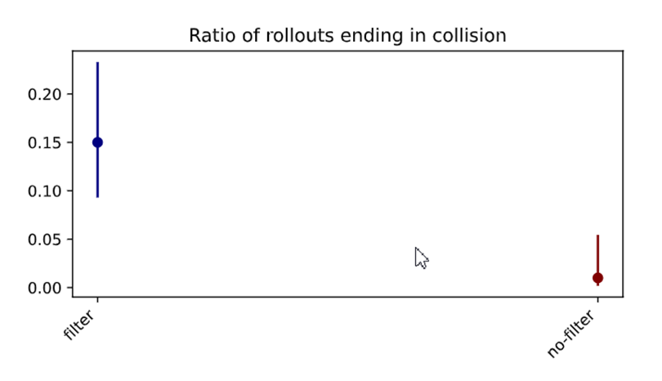
Previous Work
Implemented occlusion algorithm using object filters.
Included the object filter in the environment and observed the existing policy to crash through KPI‘s.
IDM changes in implementation.

